Slide 1

Analyzing college majors and their employment prospects
Edwin Basil mathew
Notes:
Research questions, methods, conclusions, effects Why it is important research?

Slide 2

Why bother?
College students who earn in the lowest quartile are earning less than what half the high school graduates made. (Link)
Even if students enroll in colleges, many college students don’t even end up graduating and therefore end up with student debt in addition to lack of job. While this is happening there would be high school graduates who would already have been working for 4 years without student debt (Link).
Notes:
There are studies on…….; Well-founded decisions of what to follow

Slide 3

American Community Survey Public Microdata Series (PUMS) 2010-12
174 majors with income statistics
Split by gender, grad/non-grad, employment status
Notes:
Possible ques that you have while choosing major

Slide 4
Q: What are the employment trends?
More specifically, are there any majors in which people have high employment rate, but low full-time year-round (FTYR) employment rate?
FTYR are those with job security in a major and rest with more flexible work options.
Major with widest gap between employment rate and FTYR employment rate.
Notes:
Meaning of FTYR (at least 50 weeks and 35 hours)
Imp to know stability and not just employment rates

Slide 5
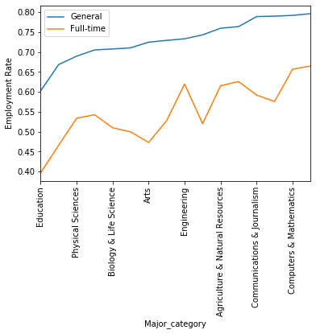
Notes:
For Arts majors, FTYR employment rate is the second-lowest
as well as the proportion of FTYR employment rate compared to overall employment rate is the lowest (seen through the wide gap).
Many of the jobs for art majors are not very stable.
For Education, both are lowest among all majors.

Slide 6
Q: Does grad school help job prospects?

Slide 7
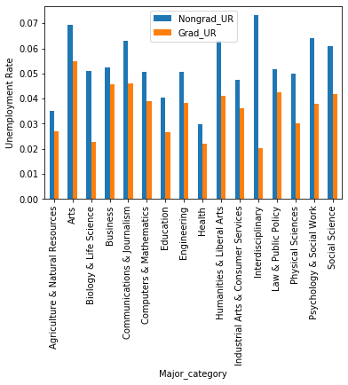
Notes:
Unemployment rate between graduates and nongraduates is widest in INterdisciplinary and smallest in Business. The gap is smallest in Business majors. Also, graduate unemployment rate for interdisciplianry majors is the lowest and Nongrad unemployment rate is highest (Got to have Grad in INterdispi). For Nongrads, Health has lowest. Good news, grads have lower UR

Slide 8
Q: Men and women dominated majors
Theme of Top 5 majors with highest % of women
Health, family and education
Theme of Top 5 majors with highest % of men
Military and Construction engineering
Notes:
Is there any overlap

Slide 9
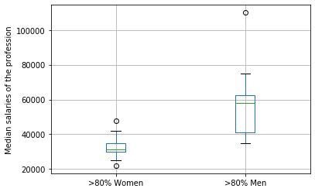
Professions with >80% women and >80% men
Notes:
The median salaries for men dominated professions is 84% higher than women dominated professions whereas the 99th percentile value (upper whisker) is 120% higher.
Interesting: what is men/women income boxplot in each bucket above?: split unavailable
I tried 90% but is too small; they don’t even overlap

